Slide 1
SCIF2001
Week 3
How to read papers effectively

Slide 2
Objectives
Download referencing software
01
Define why you are reading research literature today
02
Identify key info in the literature
03
Document notes in the referencing software
04

Slide 3
How do you find research papers?
Recap
Use a poll to get students to answer
  Choose a database
  Use key words to narrow down your list of papers to < 50

Slide 4
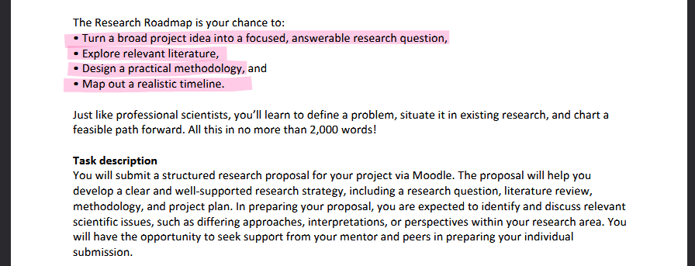
Research Roadmap – assessment structure
Explore relevant literature
Design a practical methodology
Map out a realistic timeline.
Turn a broad project idea into a focused, answerable research question

Slide 5
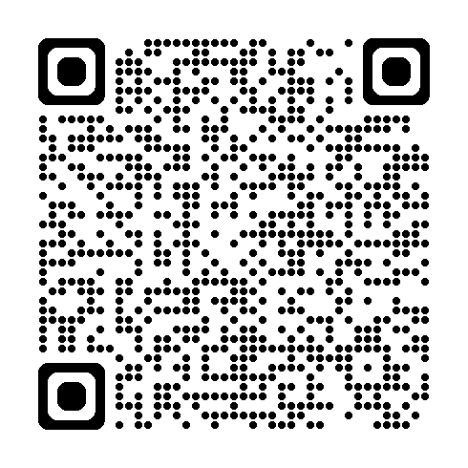
Anonymous poll:
Pros and cons of using Generative AI for your
Research Roadmap

Slide 6
Generative AI - language models
Pros
Cons
Confidently states findings/limitations that are wrong, softened, or missing
Can be good at correcting grammar, spelling, improving phrasing
careful that it doesn’t change the meaning of your sentences
How do you know the info is true?
Saves time (?)
Can be good for fundamental knowledge
Unfamiliar jargon
Often provides fake references
Ethical and environmental complications

Slide 7
Why will you need to read research articles for your project?
Assessment 1: Research Roadmap
Answer the poll in a short sentence
You may have briefly covered this in your last workshop!

Slide 8
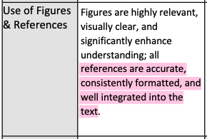
Why use referencing software?
Papers/sources you read: 50-100
Actually cited in your project:
~30
How do you keep all of that info in your head?
  In Hons, postgrad, you may cite ~100-600!
You can’t! → EndNote, Zotero or other referencing/note software
Bonus - your reference list will be automatically created
From your Roadmap rubric:

Slide 9
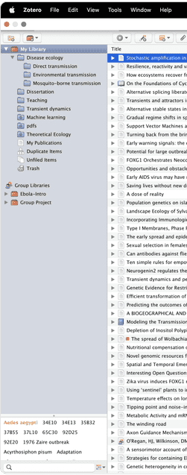
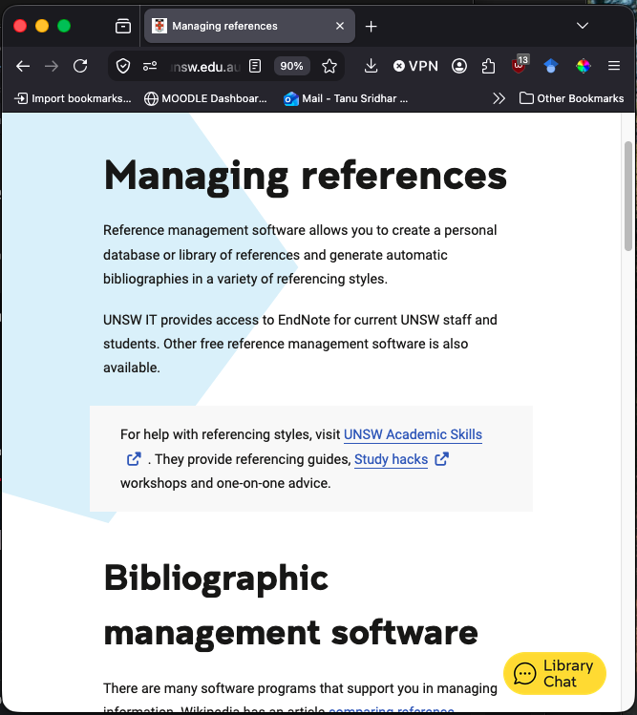

Download referencing software – a demonstration
Download a Zotero from UNSW referencing software
  You can also use EndNote if you prefer! But this workshop will focus on Zotero
Create folder called SCIF2001. Click the “New Collection…” button above the left pane
  Add a subcollection called “.to read”
  Add another subcollection called “.maybe later”
  (the “.” keeps it at the top of your list, not a typo)
Download a Zotero Connector for your browser

Slide 10
Downloading papers – a demonstration
Use a database to narrow down your search (~10-40 papers)
Look through the paper titles. Do they sound relevant?
Download 2 or 3 citations. (After class, download all the citations in your search)
Download PDFs and drag and drop into Zotero (or EndNote)
In Zotero, read titles and abstracts carefully
Does it resonate with my research topic?
Sort papers into “.to read” & “.maybe later”
Bonus: Open a Word doc. Go back to Zotero and use the insert citation tool

Slide 11
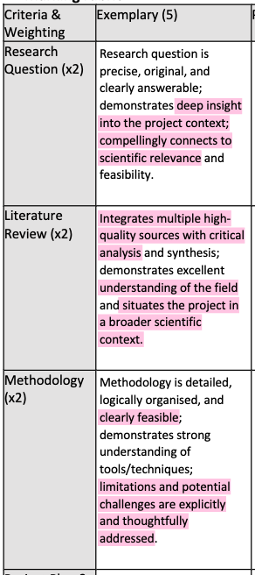
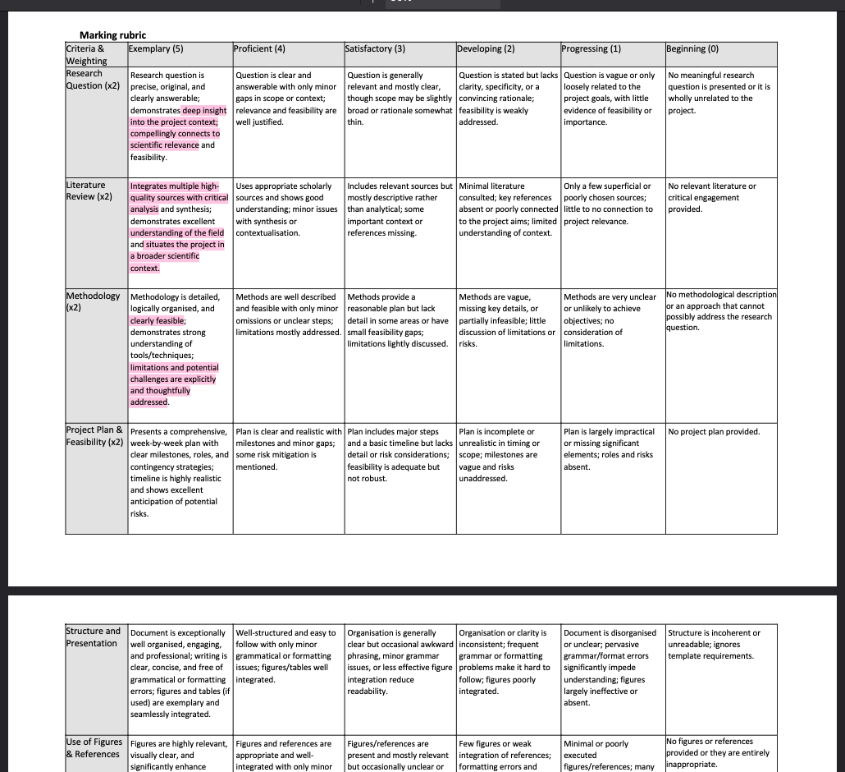
Assessment 1 – marking rubric

Slide 12
Ask yourself:
What stage of my Research Roadmap am I up to?
Building understanding of theory and perspectives in the field
Documenting rationale + ideas for chosen methodology/approach to my research question.

Slide 13
What to read after you set your reading goal
To build understanding of theory and perspectives of researchers in your field, read:
    Recent review articles
    Introduction section of original research papers
    Book chapters
To document rationale + ideas for chosen methods/approach to your research question, read:
    Results
    Methods
    Limitations, often in the discussion

Slide 14
Take short notes in Zotero while you read:
The answer to each question should ideally be 1-3 sentences max
They can also be highlighted bits of the PDFs in Zotero PDF viewer. Try not to highlight everything!
To build understanding of theory and perspectives of researchers in your field, ask: | To document rationale/ideas for your approach to your research question, ask:
What knowledge is fundamental to my research question? What do researchers disagree about? | What did the researchers aim to do? What are their most important findings? How did they find it? What are the limitations or biases in this study? Limitations stated by the authors, + anything you notice they didn't flag (funding source, sample skew, small sample, non-replication)

Slide 15
How much reading is enough?
While reading your papers you should be scanning the reference lists! Ask yourself:
  Are there studies relevant to you?
  Have you seen these relevant papers before?
  Are the authors of relevant papers becoming familiar? This is a good sign you
Do new sources start confirming what you already know rather than adding anything?
  This is a good sign you are ready for the next stage

Slide 16
What did the researchers aim to do?
What did they find?
How did they find it?
What are the limitations or biases in this study?
How does this relate to my study?
Look over the reference list! Is anything there relevant to you?
  How much is enough reading? When you begin to see the same kinds of names again and again in the references
https://www.youtube.com/watch?v=8MYWqvrk1QE

